Slide 1
BULL STOCK
By,
TRIV2VER
Vishwanath Kulkarni

Slide 2
Introduction
What Does stock means?
What does Stock exchange means?
Who can do stock exchange?
What’s its scalability?

Slide 3
Introduction
Bull stock is an Framework for both android app and web app.
It will allow student’s to get hands on with virtual stock trading.
An app for future fluent trading.

Slide 4
Problem being solved
An knowledge bridge between students and stock exchange.
Measuring and controlling the Risk by analysis using parse API’s and google chart API’s.
Educating Students for better money control’s.

Slide 5
Technology Stack
Can be listed in 2 topics.
One, Front-End
Android app
Android bootstrap
Web application
Javascript
mp android charts
Stock details by yahoo.
Second, Back-end
Parse API calls.

Slide 6
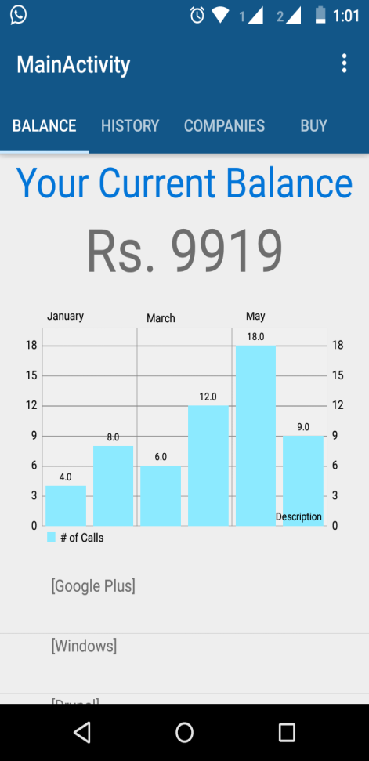
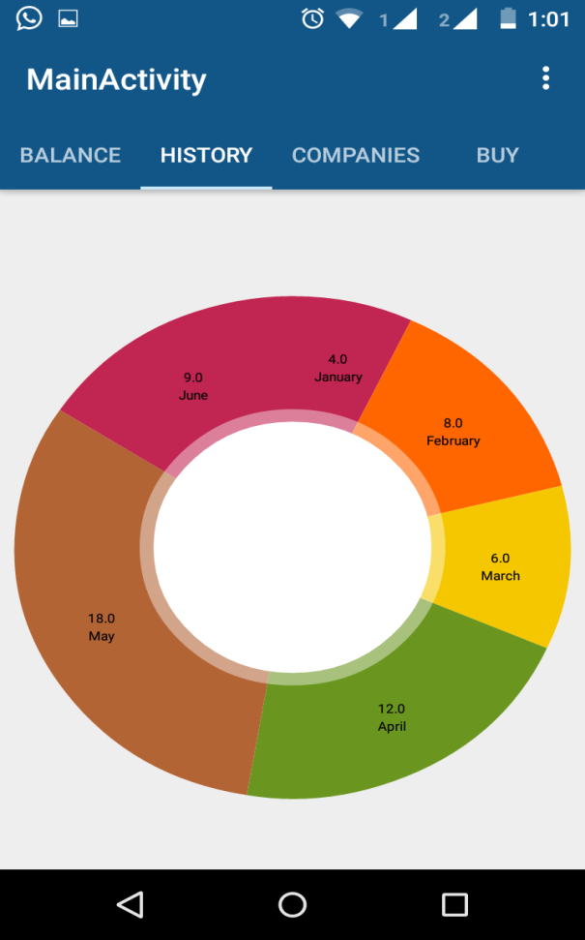
Screenshots

Slide 7
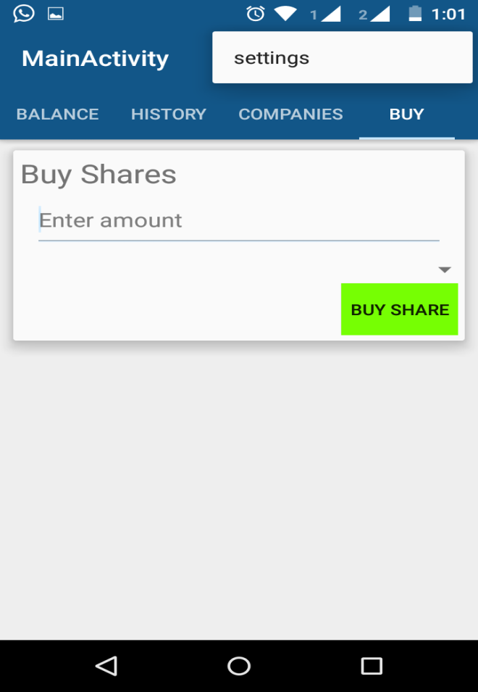
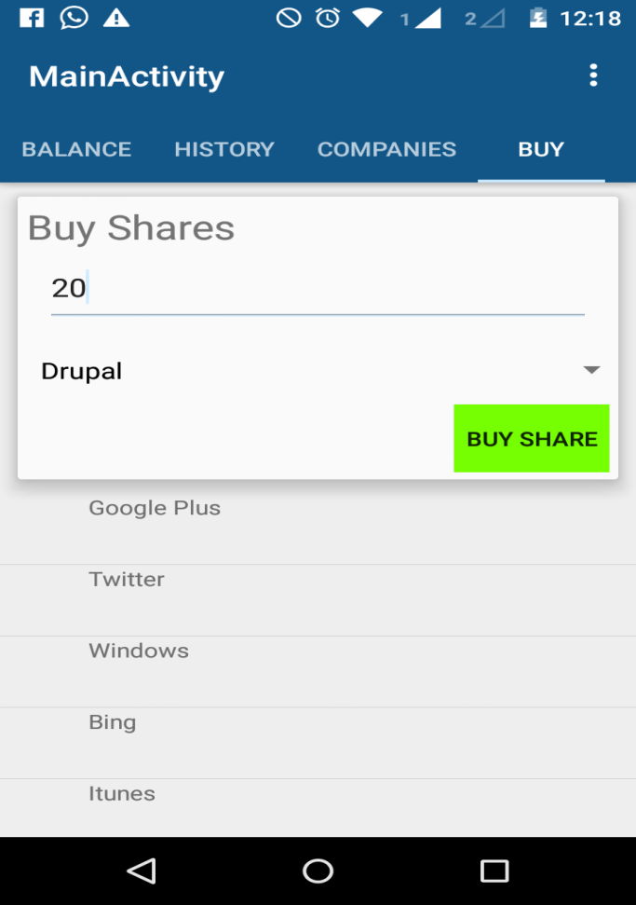
Screenshots

Slide 8
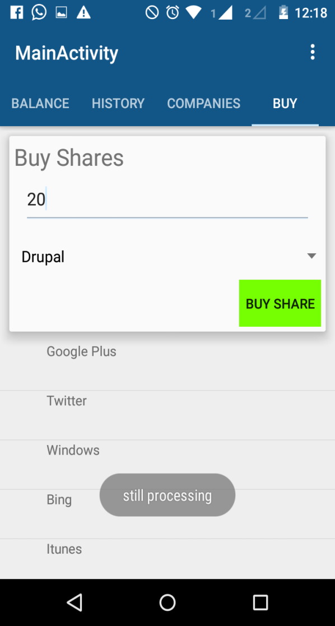
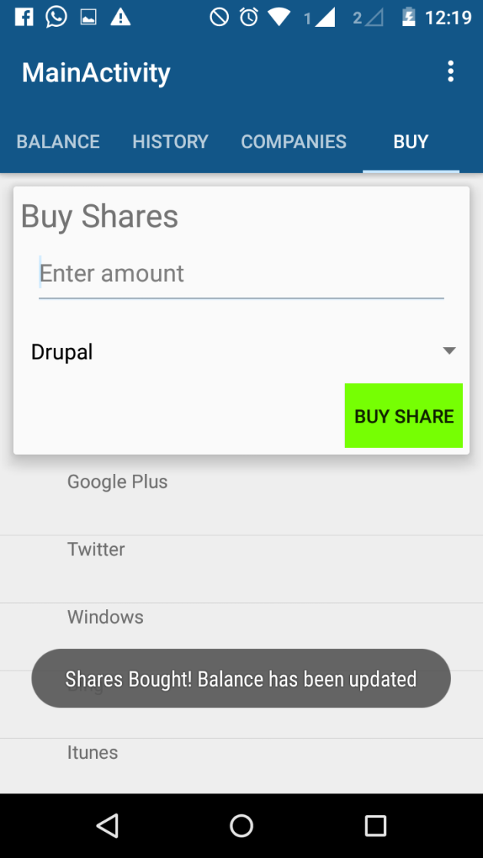
Screenshots

Slide 9
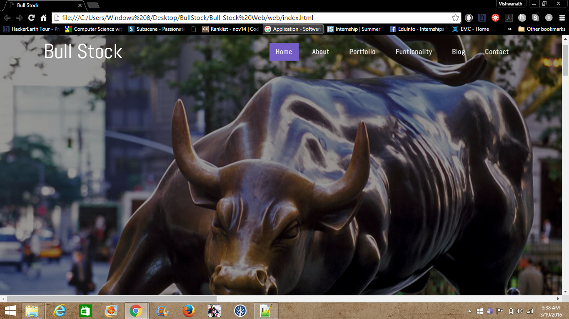
Screenshots

Slide 10
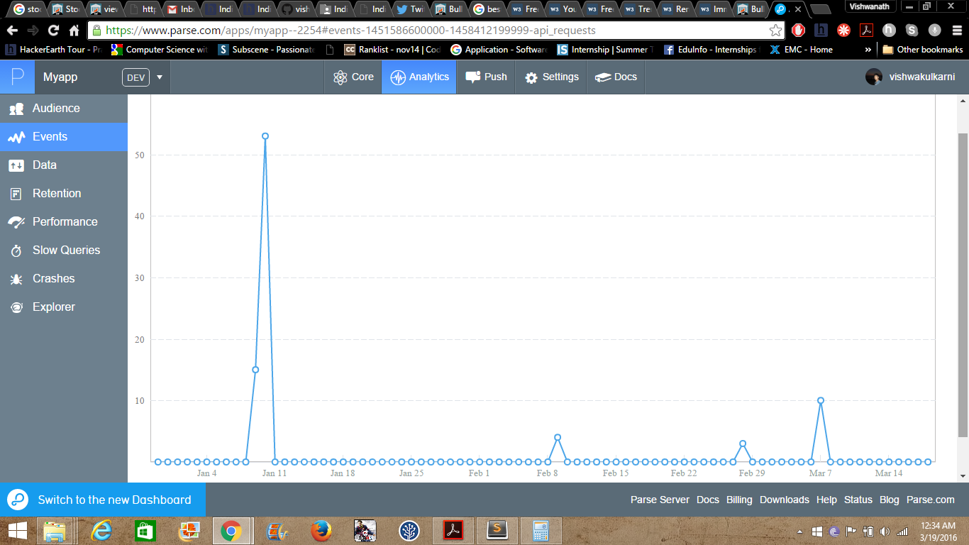
Screenshots

Slide 11
Challenges faced
Storing data and getting its analytics.
Maintaining ACID properties for buying and selling of shares.
Analysing the data in android app.

Slide 12
Future Scope
Oh! There is very vast scope for this app.
Limitless because students are India’s future.
Wonder for real stock exchange happening.
Nearly 1511 colleges are there in India and 200 students per college, which will account for around
1151*200 = 230200 students every year.
230200/2=115100 * 10rs =11511000 per year.

Slide 13
Future Scope
Few more additions.
Complete web portal with back end handling brokers.
Investment from students to Start-ups.
More investments less risk.

Slide 14
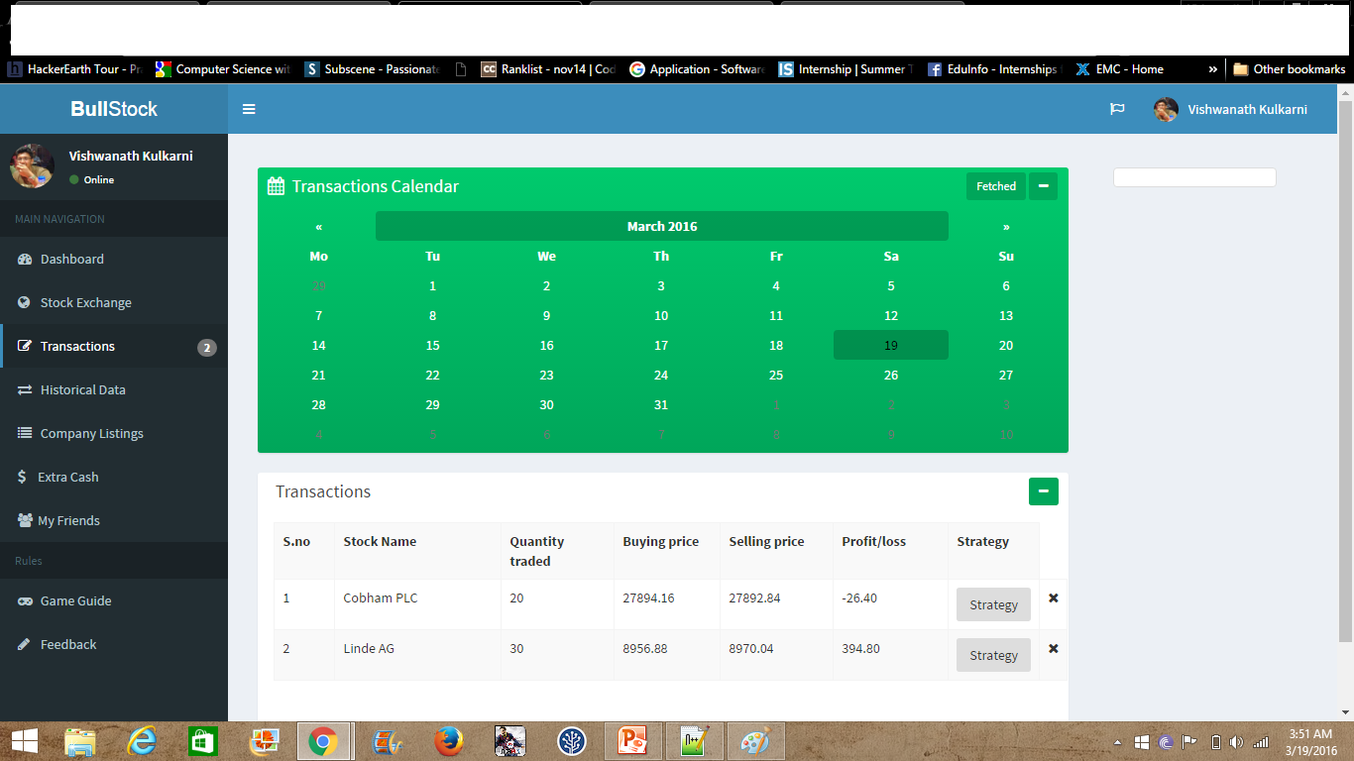
Future Build

Slide 15
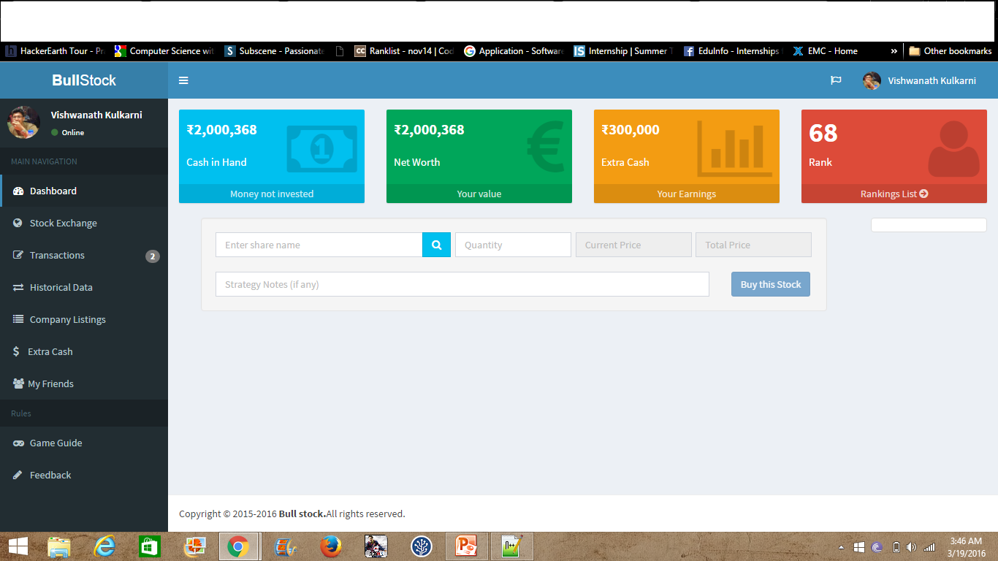
Future Build

Slide 16
Thank you
ANY Questions?

